Slide 1
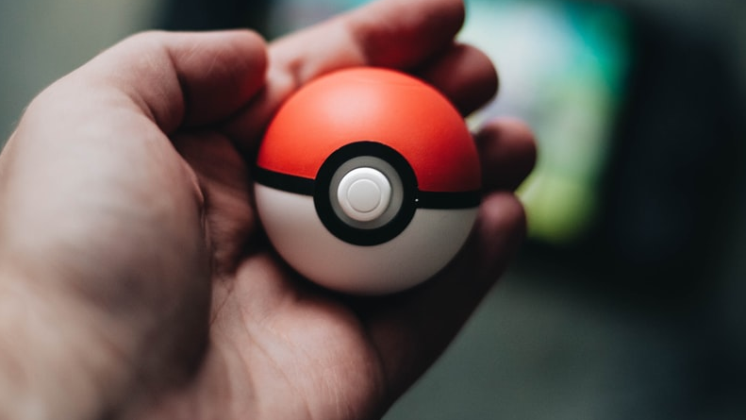
Who’s that Pokémon? (Card)
A.I. image classification
Notes:
Kamil S from https://unsplash.com/

Slide 2
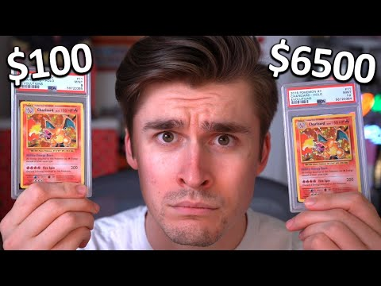
Introduction
Popular trading card game owned by Nintendo.
Can collect cards as well as play competitively.
Individual Cards can be very valuable
Streamer Ludwig stunned by Pokémon Card values

Slide 3

Problem Statement
Gotta classify ‘em all!
The goal is to allow players or collectors to add their collections online easily.
Scanning cards easily gives benefits to hobbyists and investors..
How can I write a program that can determine what Pokémon card it sees when it detects an image to help people catalogue their collections.
How to best use Neural networks learn patterns to identify images.

Slide 4


Data Source
Pokemon TCG API is and PokemonClassifier dataset from Kaggle was used to collect image data.
https://pokemontcg.io/

Slide 5
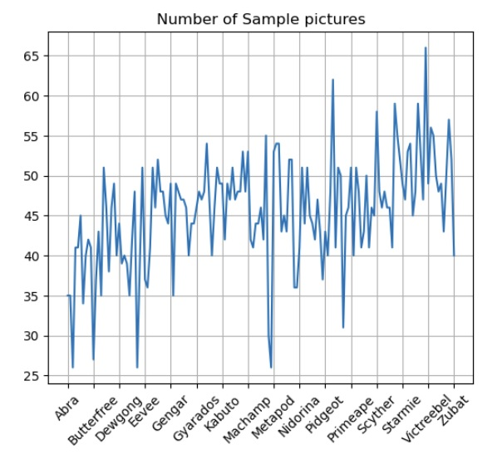
Exploratory Data Analysis
Averange number of pictures is 45.5.
Venusar, Pikachu, Snorlax and Scyther have the most pictures.
Null model is 0.95% accurate.

Slide 6
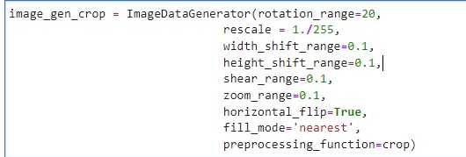
Model/Data Preprocessing
Two Convolutional Neural Network models

Slide 7
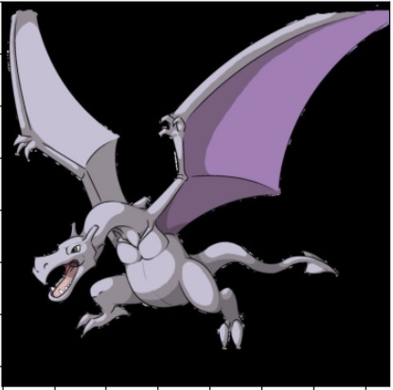
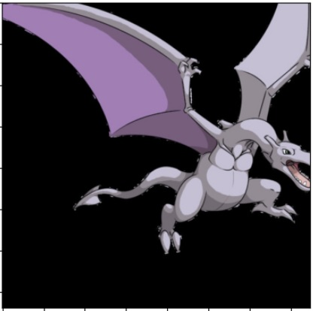
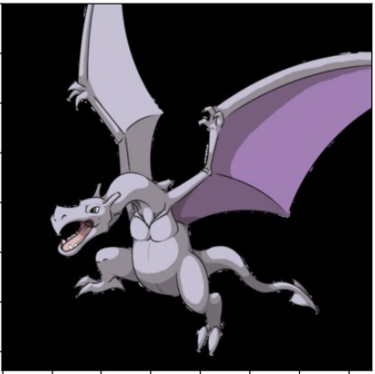
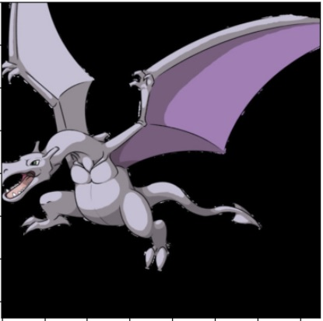
Model/Data Preprocessing

Slide 8
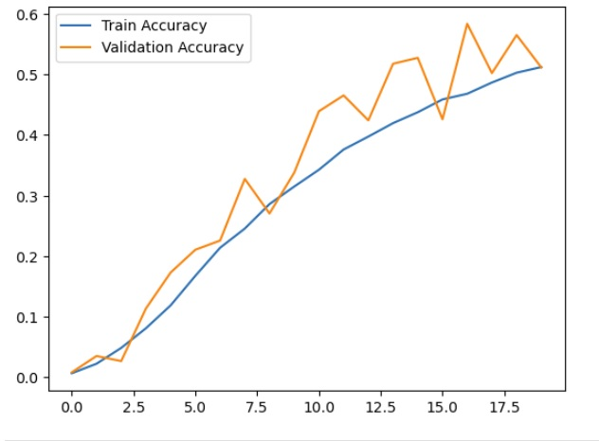
Results
Model 1, Validation Accuracy 51.4%
Model 2 Validation Accuracy 59.2%

Slide 9
Conclusion/Next steps
50% accuracy shows the model is detecting a signal in the card images for classification
It is difficult to have high accuracy when there are a lot of classes, good idea to use early stopping and drop out layers.
Can generate fake damage and analyze card for value.

Slide 10

Questions

